Slide 1
Inventory System
AMIRUN AKMAL DANIEL BIN MUHD NAZRI A18CS3043
MUHAMAD AZRUL BIN FUAZAM A18CS3051
DANIEL BIN ARIPIN B18CS0004
Programming Technique 2
SCSJ1023-09

Slide 2
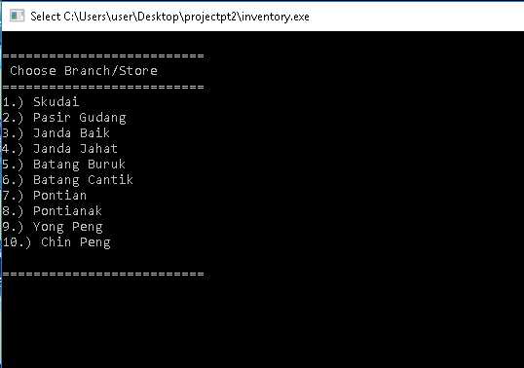
Interface of Inventory System

Slide 3
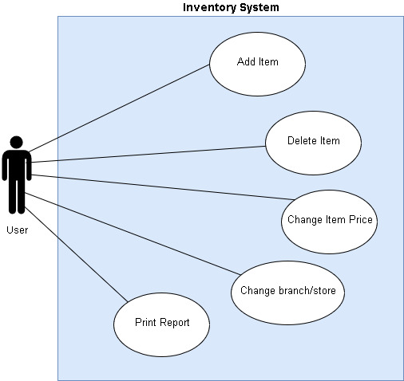
Uses Cases

Slide 4
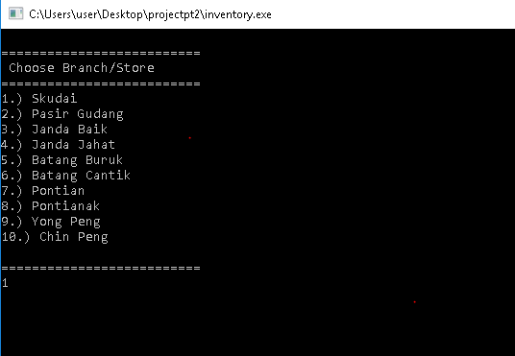
Step 1:
Contain list of branch/store that has been registered.
Choose which branch that User want to handle or supervise.
Example: Select branch number 1 and press enter.

Slide 5
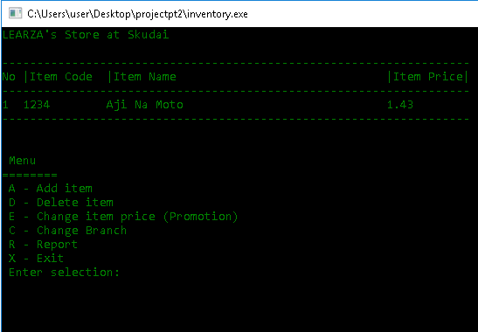
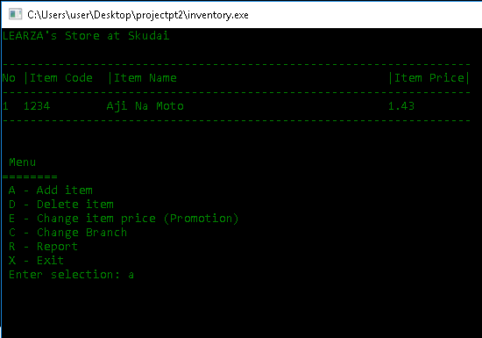
Step 2: Add Item
This is Add Item Features.
User can use this add item/ product inside this system
Key-in ‘a’ to add item to inventory list

Slide 6
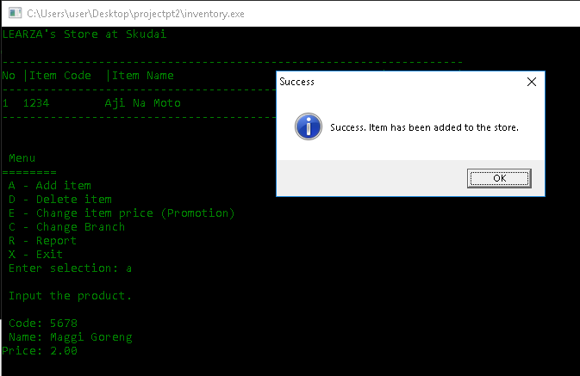
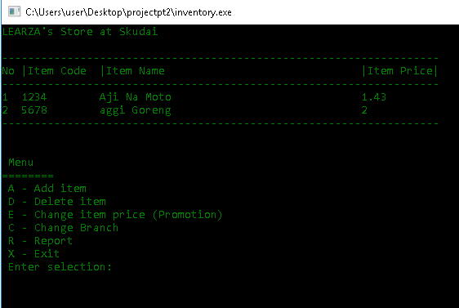
Step 3: Add Item
Enter the item details : code number, name and price of the item
The detail of the item will be save and show on list

Slide 7
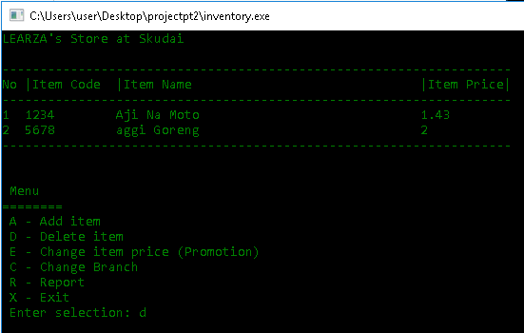
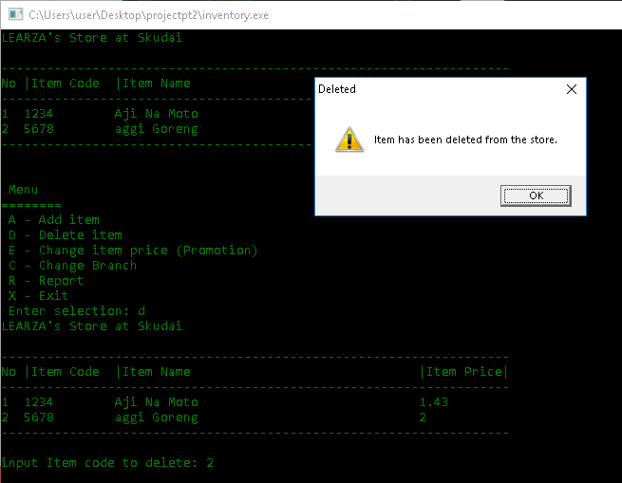
Step 4: Delete Item
This feature is to delete the unused item on the inventory list.
User can remove it by entering the item number list.

Slide 8
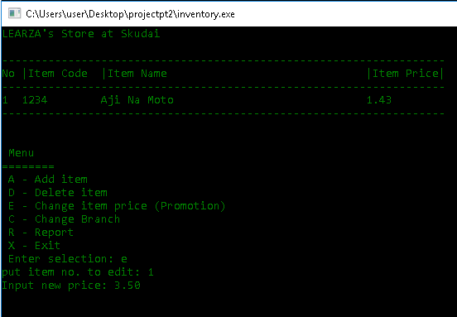
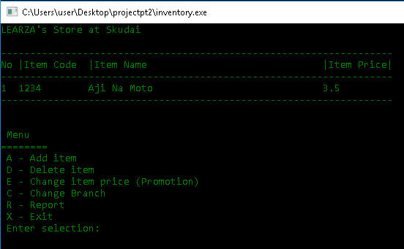
Step 5: Update Item Price
User can update their price if got discount or promotion.
The old price will be replace to the new price.

Slide 9
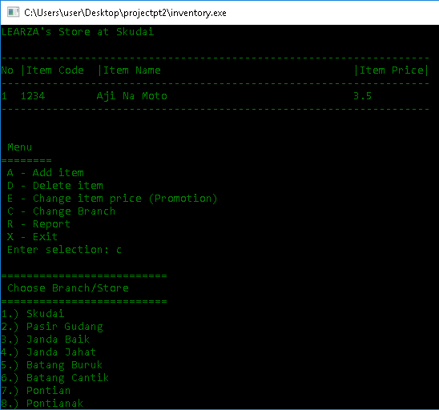
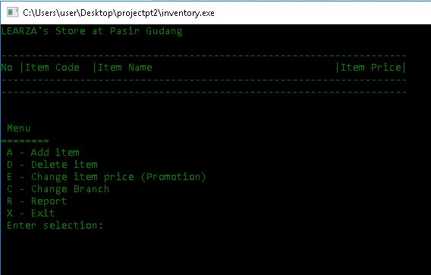
STEP 6: Change Branch/Store
The user need to input which branch they ant to view
User can view other store/branch on different location.
Can update each of the branch their inventory list.

Slide 10
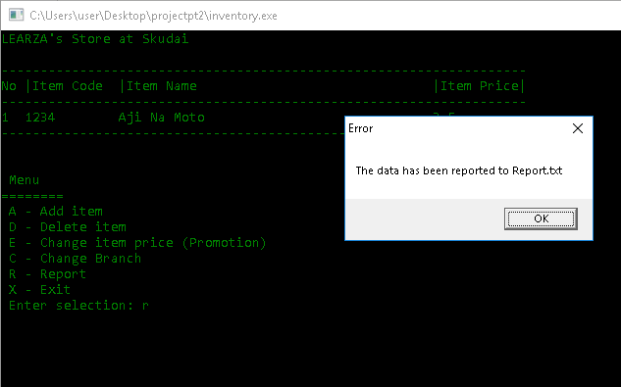
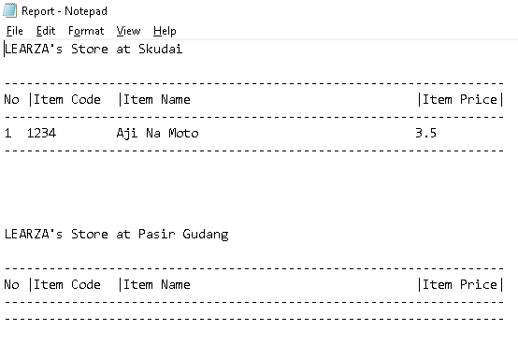
Step 6: Print Report
Manager can print out the inventory system detail into txt.file.
Manager can view the detail for each branch of the inventory system

